Slide 1
BB2950 Day 11: Friday 11-10-17
Learning objectives:
Describe the chemical reactions that underlie DNA polymerization and 3’ to 5’ exonuclease activity.
Compare and contrast the use of 5’ to 3’ vs 3’ to 5’ exonuclease activity by Pol I and Pol III, and explain when and where these activities are used during DNA replication.
Explain how DNA replication is initiated.
Explain why telomerase shorten during DNA replication, and how telomerase prevents this.
The Shell lab is looking for a work-study student to help with dishwashing, media preparation, and experiments. Do PCR and Gibson Assembly for real! Email Prof. Shell if interested.

Slide 2
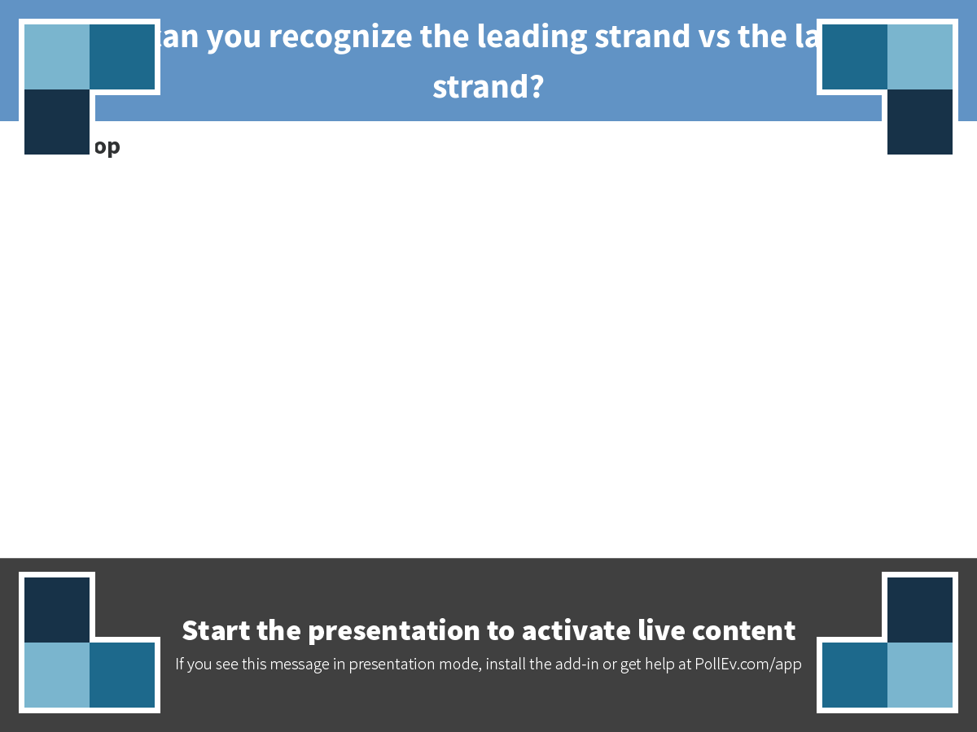
Notes:
How can you recognize the leading strand vs the lagging strand?
https://www.polleverywhere.com/discourses/KW0Pm7FgyMOlQ52

Slide 3
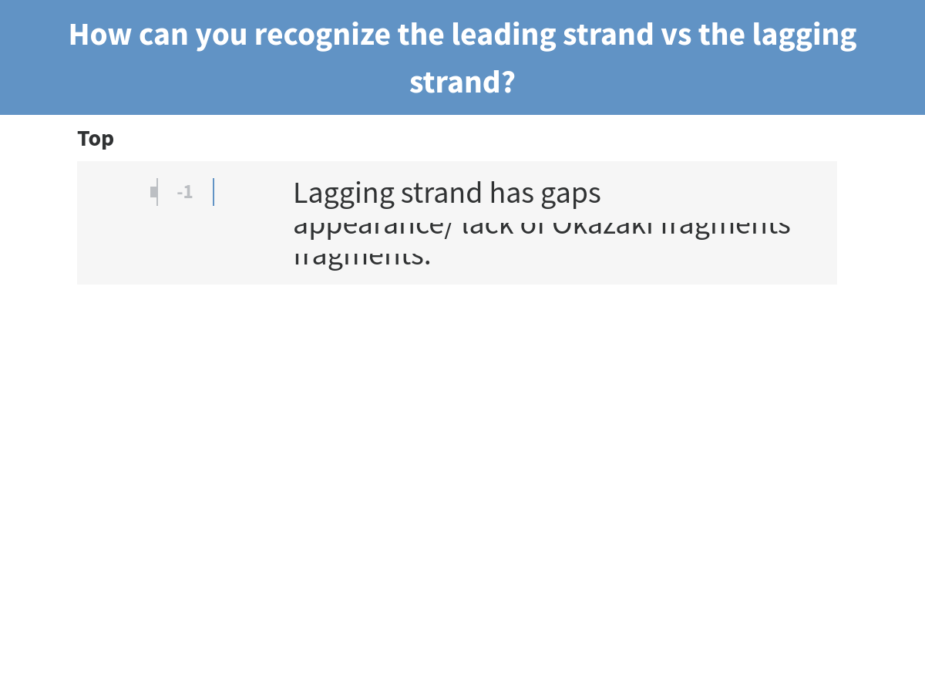
Notes:
How can you recognize the leading strand vs the lagging strand?

Slide 4
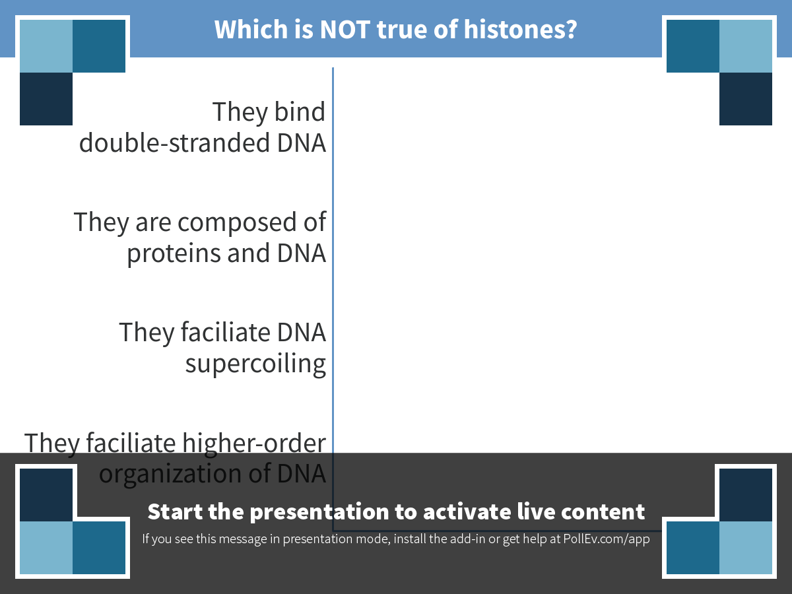
Notes:
Which is NOT true of histones?
https://www.polleverywhere.com/multiple_choice_polls/UtAP7ZyI0pz0r47

Slide 5
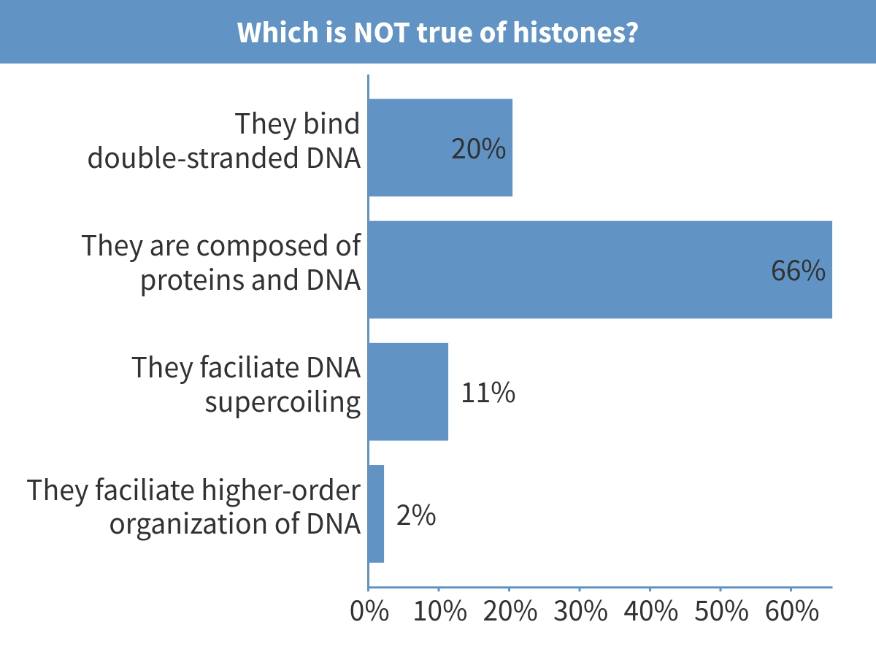
Notes:
Which is NOT true of histones?

Slide 6
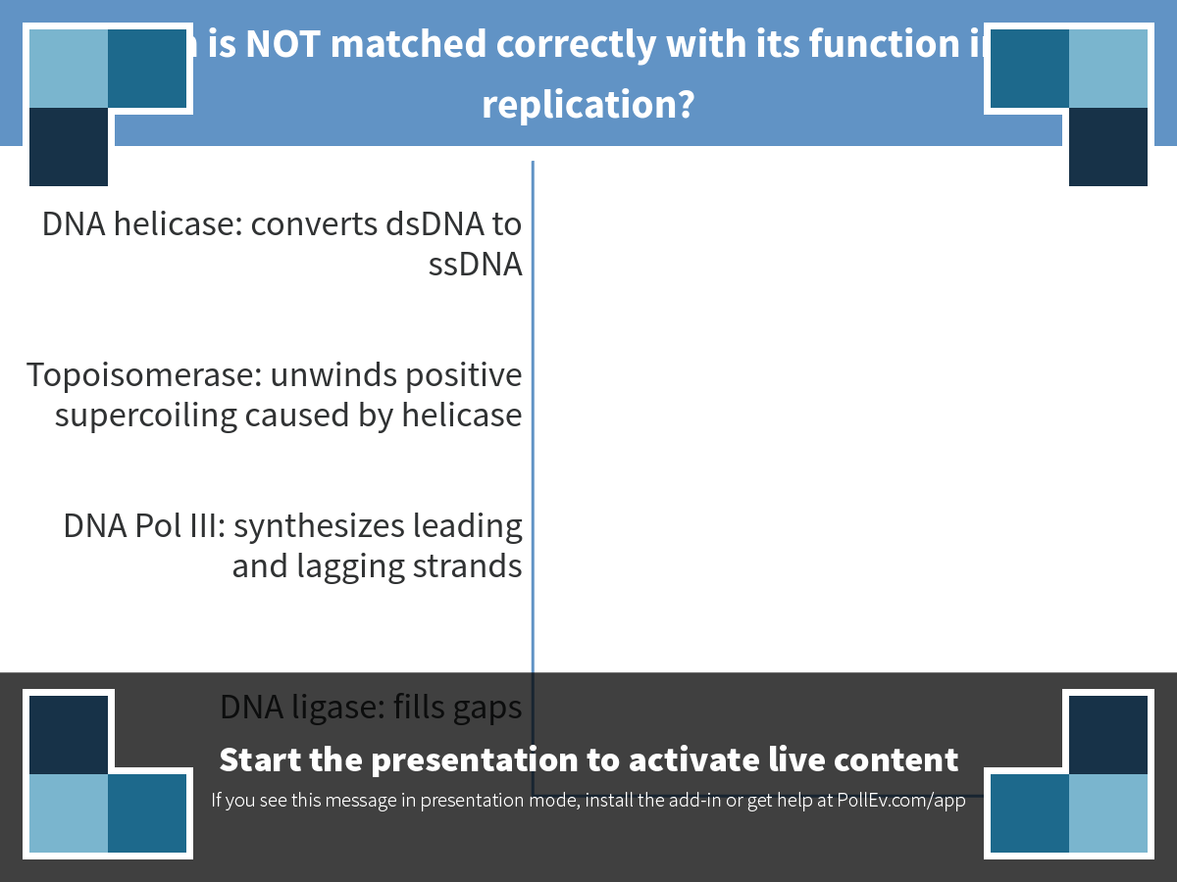
Notes:
Which is NOT matched correctly with its function in DNA replication?
https://www.polleverywhere.com/multiple_choice_polls/OM7iSwetgLjICY7

Slide 7
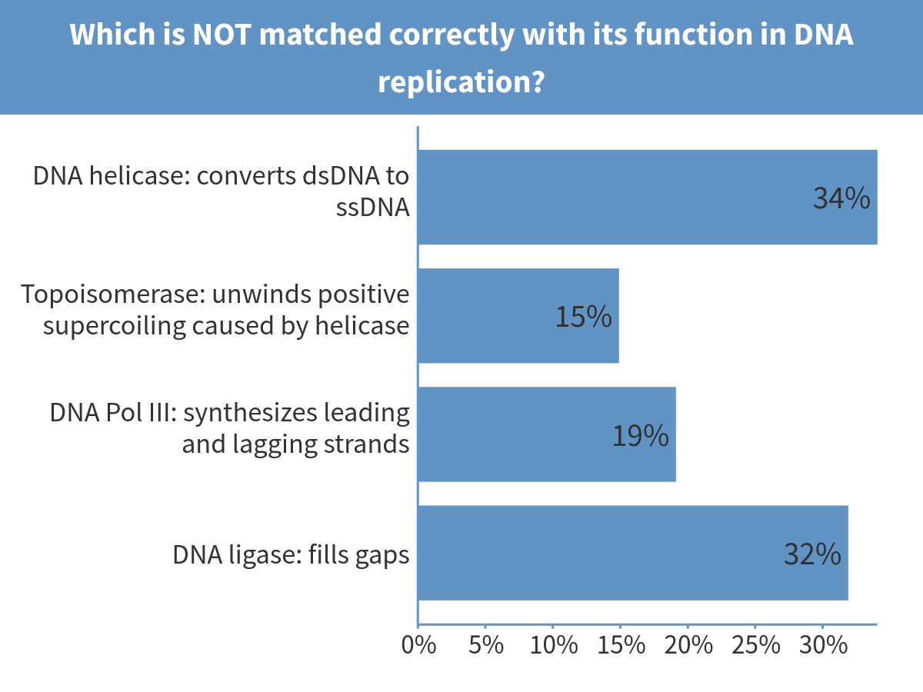
Notes:
Which is NOT matched correctly with its function in DNA replication?

Slide 8
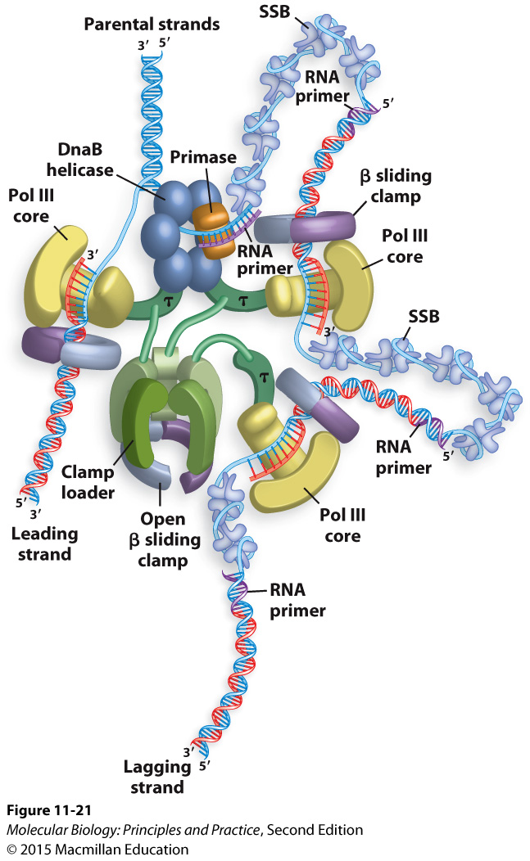

What other proteins are required to complete replication?
Notes:
(topoisomerase, Pol I, ligase)

Slide 9
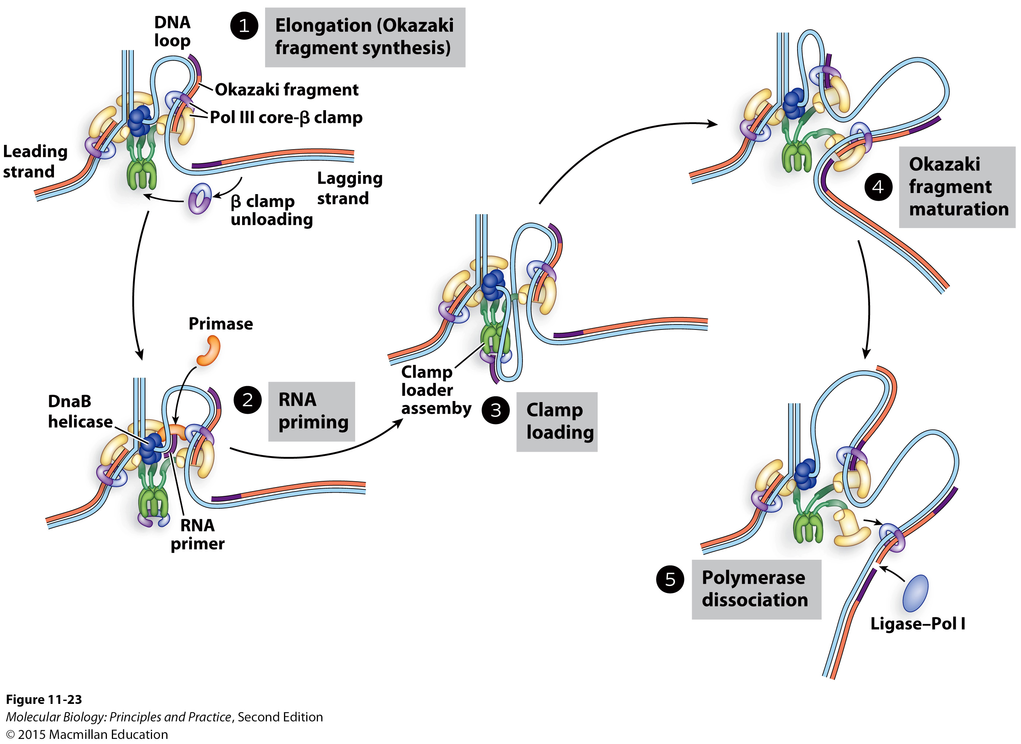
The clamp loader continually replenishes Pol III and Beta clamp on the lagging strand, and spatially links leading and lagging strand synthesis.

Slide 10
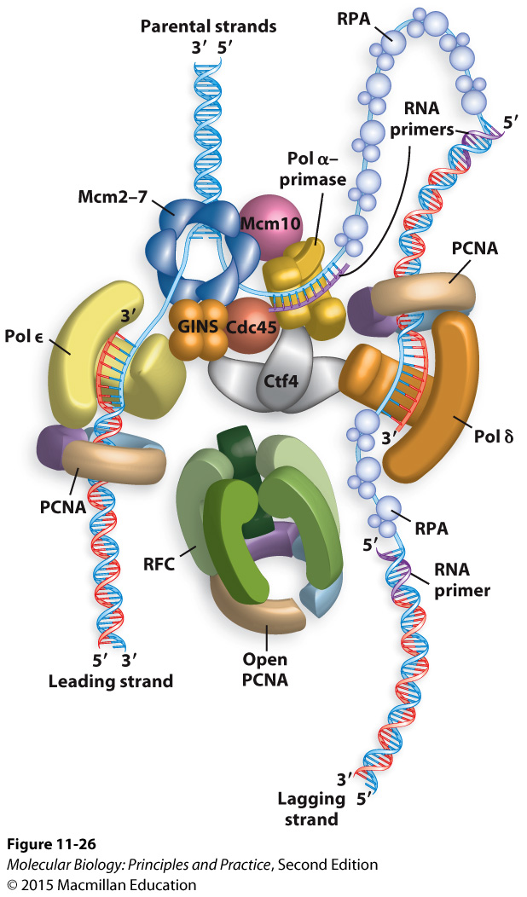
Eukaryotic replisomes are composed of functionally homologous proteins

Slide 11
The chemistry of DNA polymerization

Slide 12
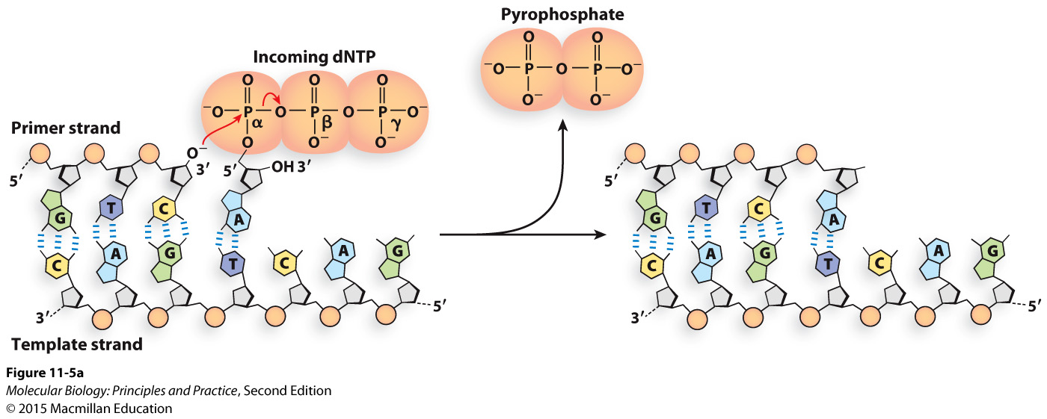
The chemistry of DNA polymerization
Notes:
What kind of reaction is this? Which atom is the nucleophile?

Slide 13
The chemistry of DNA polymerization
Replacing one high-energy bond with another is energetically close to neutral.
Formation of hydrogen bonds and base stacking interactions make DNA polymerization energetically favorable.
Much of the energy needed for DNA polymerization therefore goes into synthesis of the dNTPs.
Notes:
What kind of reaction is this? Which atom is the nucleophile?

Slide 14
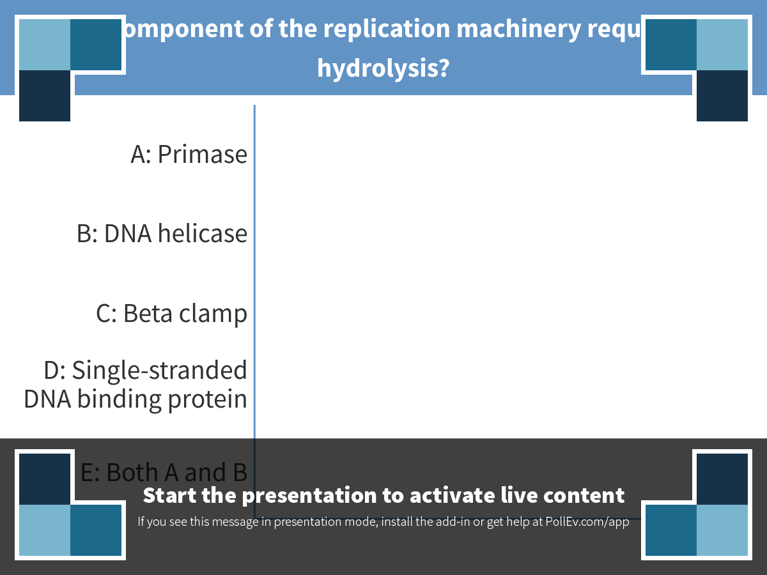
Notes:
Which component of the replication machinery requires ATP hydrolysis?
https://www.polleverywhere.com/multiple_choice_polls/Za022en7cAI2A5h

Slide 15
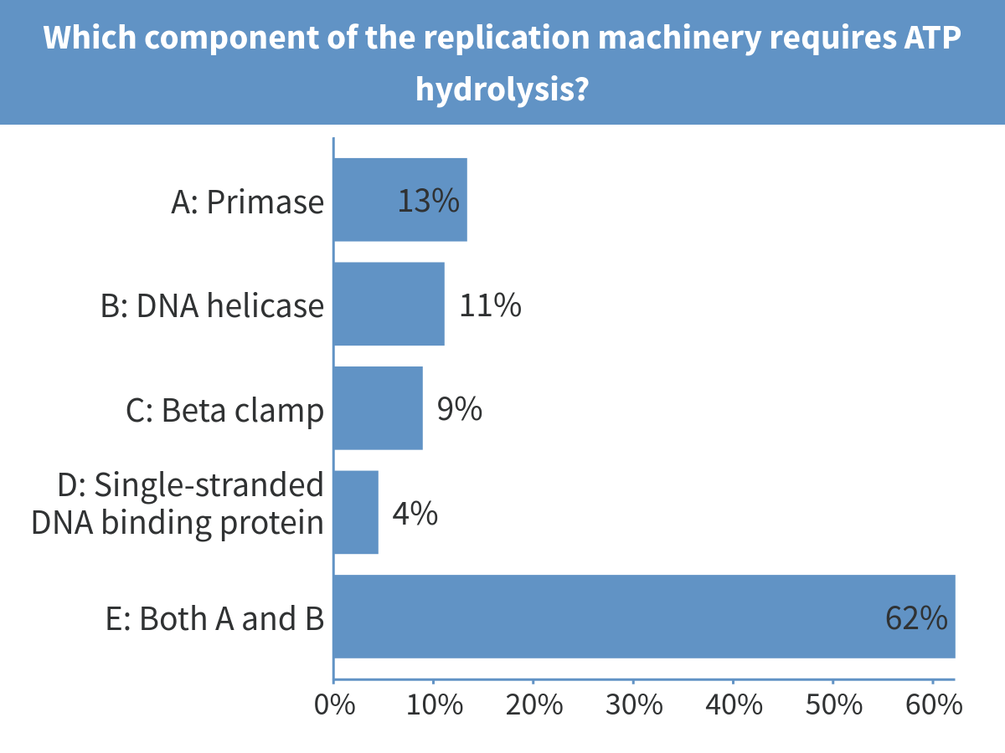
Notes:
Which component of the replication machinery requires ATP hydrolysis?

Slide 16
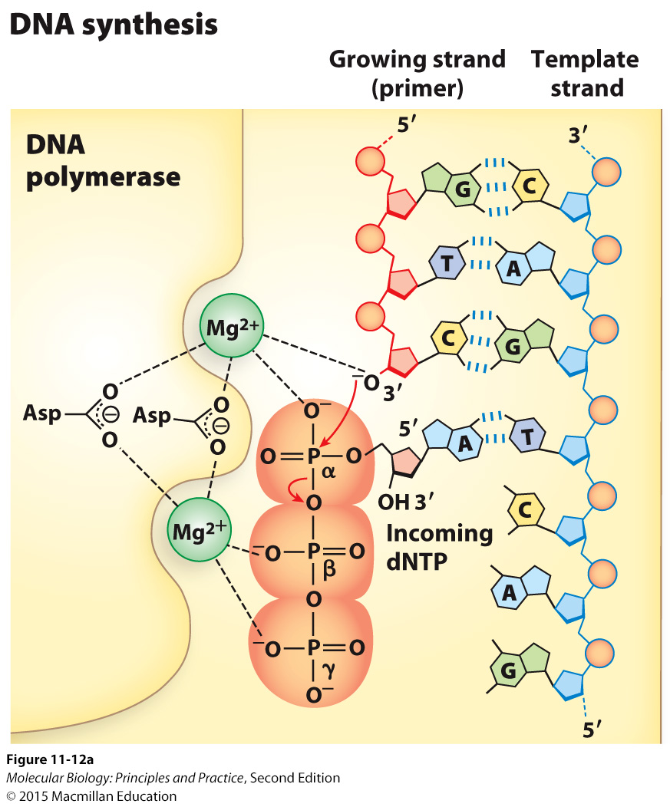
Magnesium ions are essential for catalysis by DNA polymerase

Slide 17
Many DNA polymerases have exonuclease activity
DNA Pol III:
3’ to 5’ exonuclease activity:
DNA Pol I:
3’ to 5’ exonuclease activity:
5’ to 3’ exonuclease activity:
Exonuclease activities are contained in separate domains or active sites (not a reversal of the polymerization reaction)

Slide 18
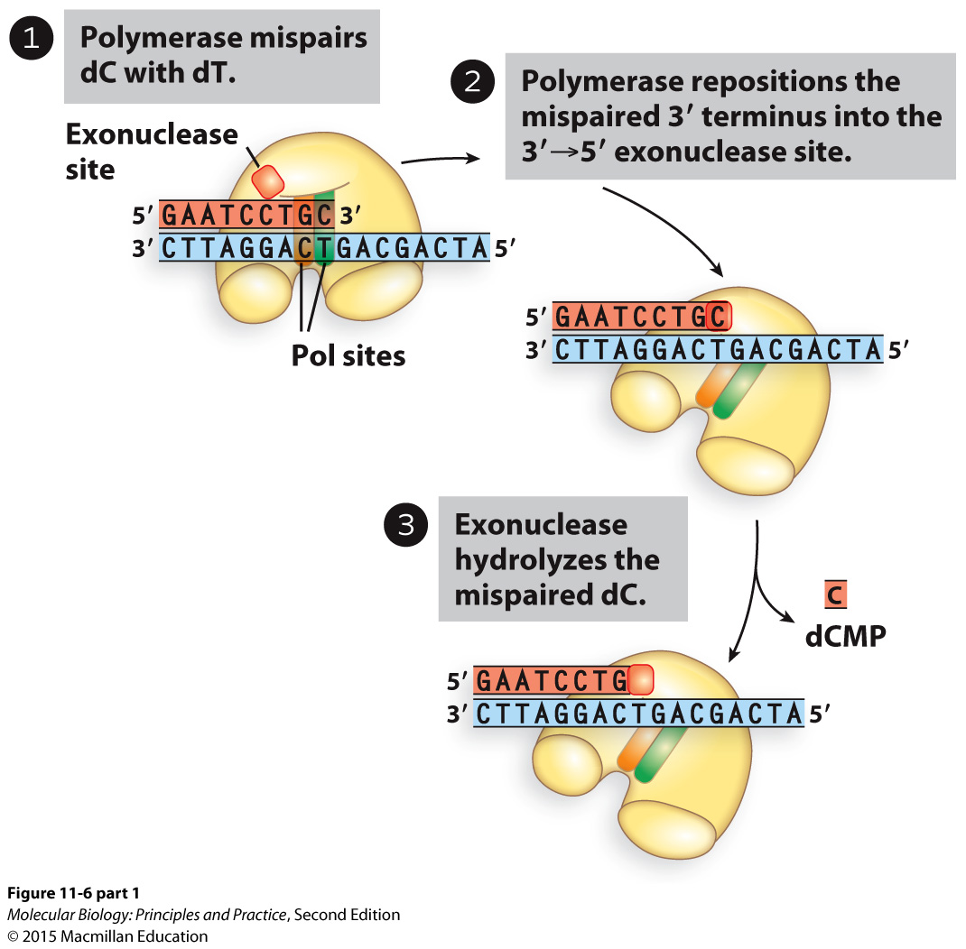
Proofreading via 3’ to 5’ exonuclease activity

Slide 19
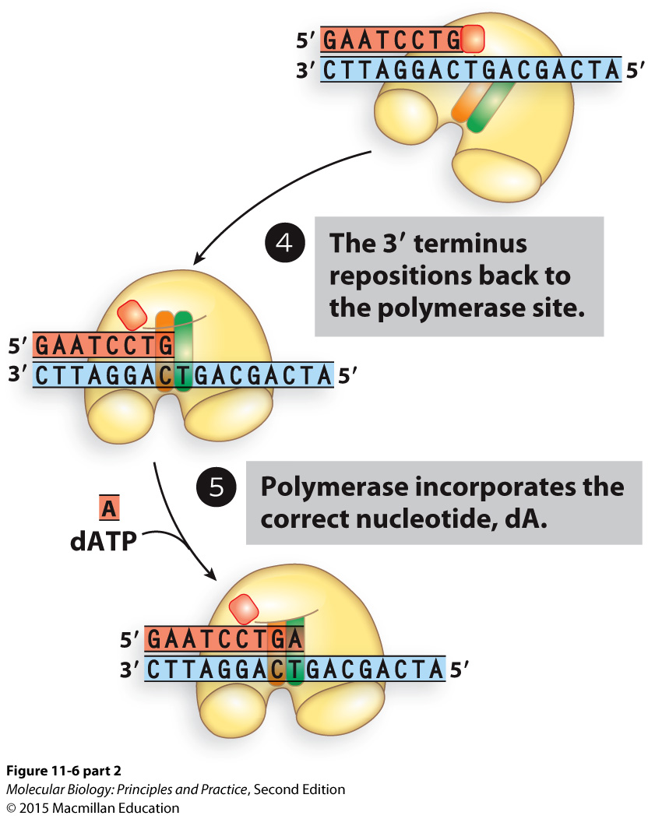
Proofreading via 3’ to 5’ exonuclease activity (continuted)

Slide 20
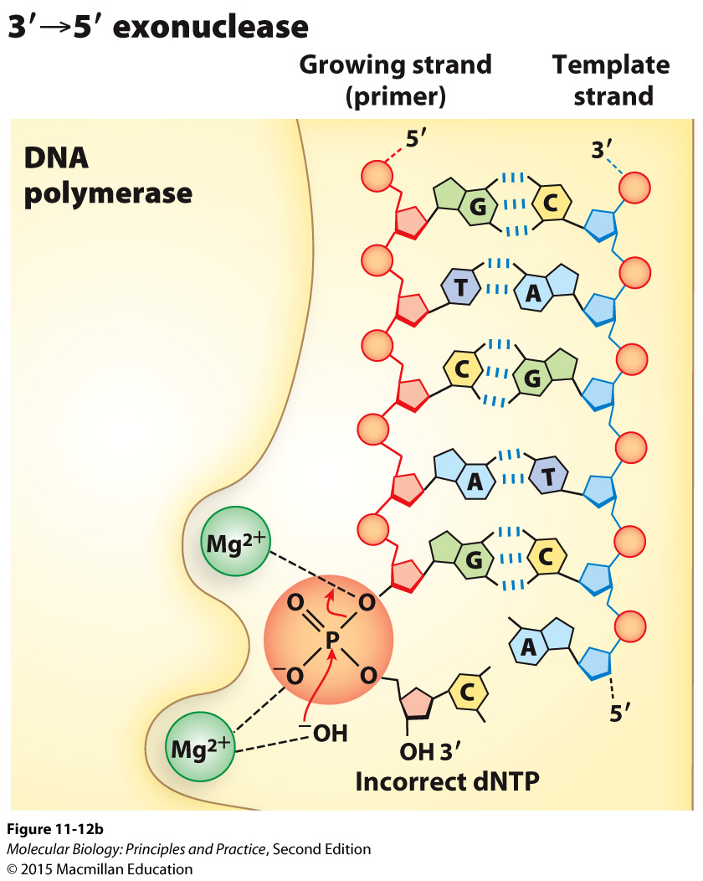
The chemistry of 3’ to 5’ exonuclease activity

Slide 21
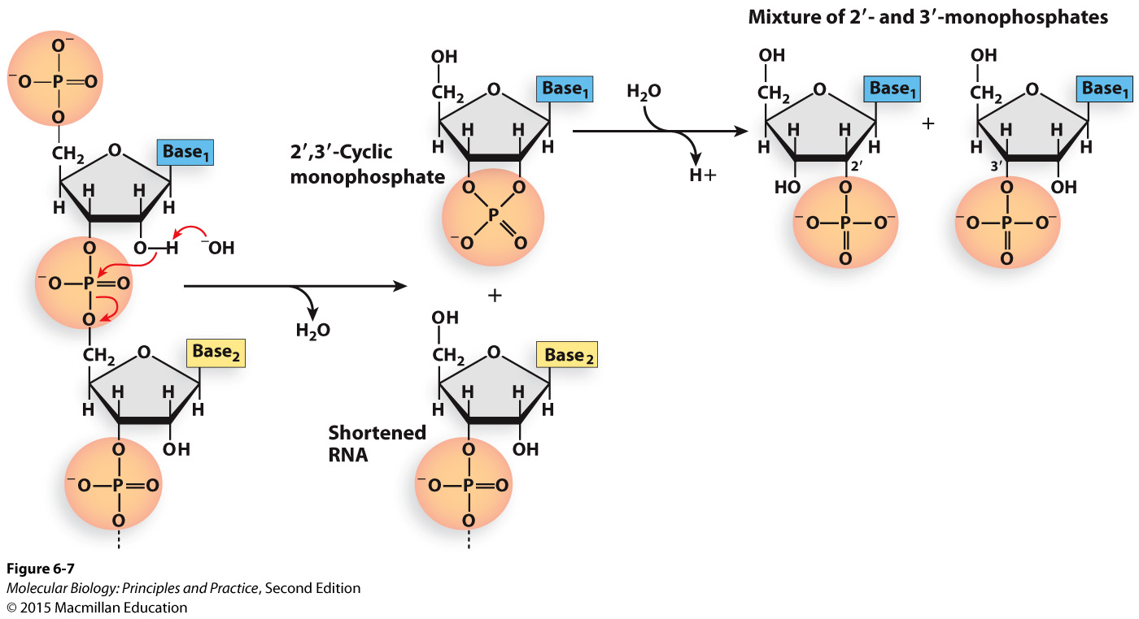
Similar chemistry here, where ribose’s 2’ hydroxyl can hydrolyze RNA.

Slide 22
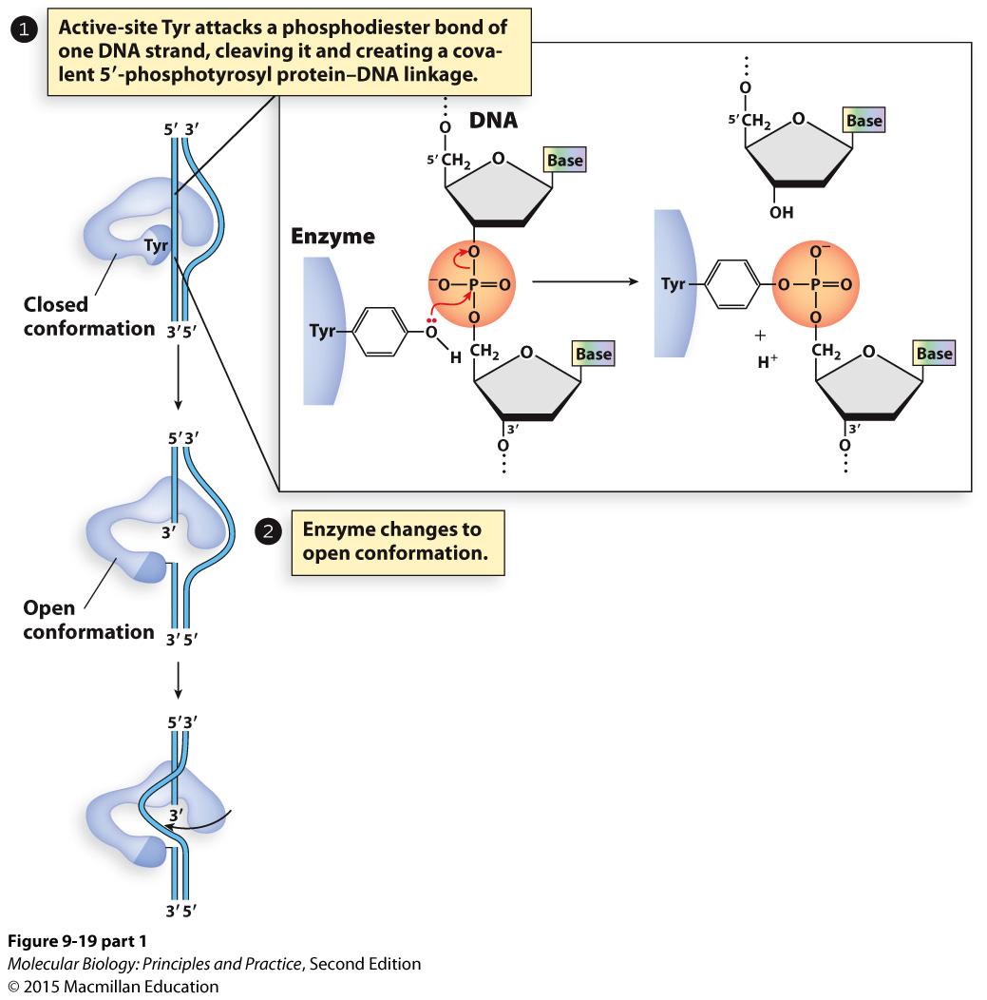
Similar chemistry here too with bacterial topoisomerase I

Slide 23
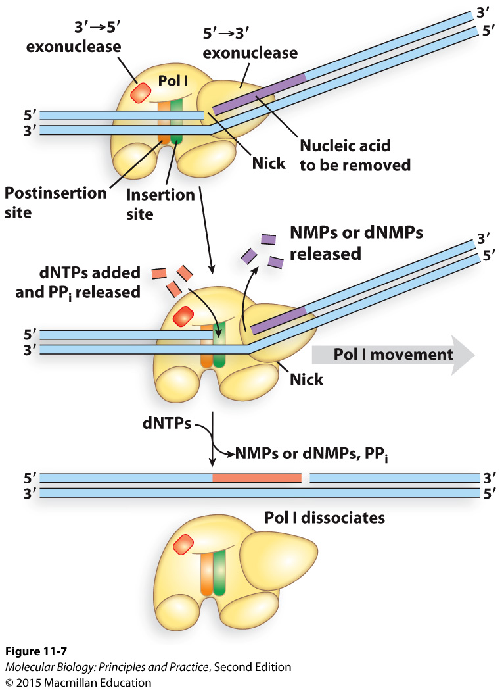
Pol I uses 5’ to 3’ exonuclease activity to remove RNA primers and then replaces them with DNA

Slide 24
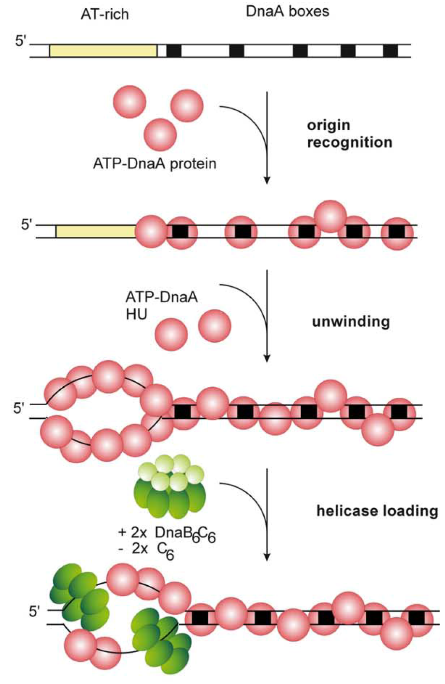
Initiation of DNA replication
DnaA is the initiator in bacteria.
In eukaryotes, the origin recognition complex (ORC) performs an analogous function.
The expression, binding, and activity of DnaA and ORC are highly regulated.
Messer, W. (2002) FEMS Microbiology Reviews, 26(4), 355–374.

Slide 25
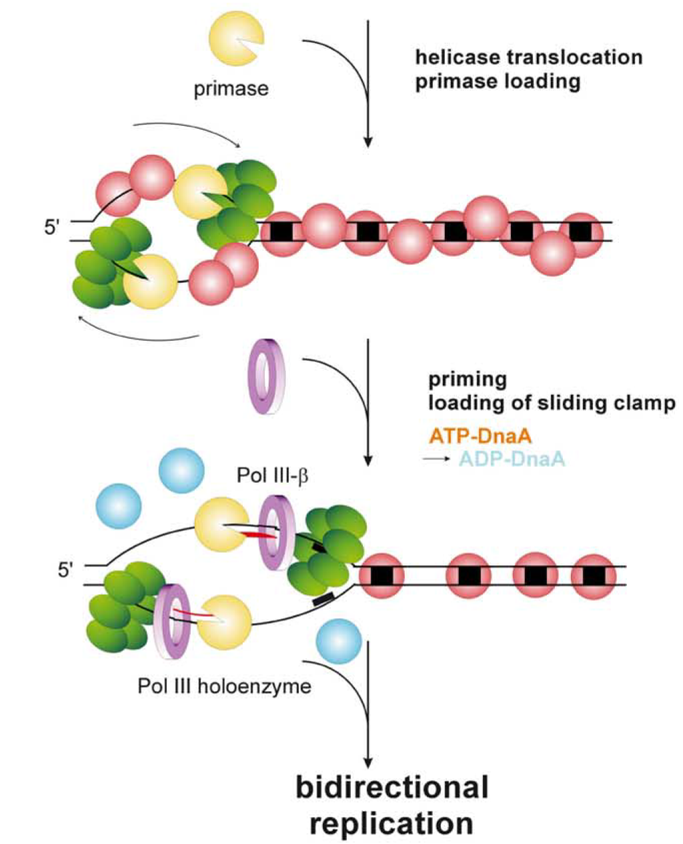
Initiation of DNA replication
DnaA recruits the helicase and helicase loader; helicase recruits primase; etc.
Messer, W. (2002) FEMS Microbiology Reviews, 26(4), 355–374.

Slide 26
Terminating replication
Circular prokaryotic chromosomes: replication forks collide and fall apart, gaps are filled in and nicks ligated together.
Linear eukaryotic chromosomes: forks collide or run off ends. In some organisms and cell types, telomerase prevents shortening of the chromosomes due to incomplete lagging strand synthesis.

